Slide 1
Diagnosing the Nonalcoholic Fatty Liver Disease Using Machine Learning Algorithms
Data Science Capstone Project
Lirong Peng

Slide 2
Problem Statement
The overall error in medical diagnosis ranges from 10% to 15% [1].
Diagnosis error can lead to endless suffering of a patient.
It is very challenging to improve diagnostic accuracy using traditional clinical practice.
Grber, M.L. 2013

Slide 3
Literature Review and Project Scope
Studies show that machine learning is a promising strategy of artificial intelligence in providing early and accurate diagnosis and prognosis equal to or better than clinical experts [2-6].
To evaluate and compare the predictive performances of different machine learning models on a specific disease.

Slide 4
Dataset
Criteria for choosing the dataset:
Represents a common disease that is diagnosed using a typical clinical practice.
Has a reasonable sample size.
Has comprehensive features from the electronic health records.
Dataset:
Nonalcoholic fatty liver disease (NAFLD)
From an annual health examination study in China [6].
Man, H, et. al. 2018

Slide 5
Methodologies
Models:
Conventional classification models:
K-nearest neighbor
Logistic regression
SVM
Naïve Bayes
Decision tree classifier
Ensemble algorithms:
Random Forest classifier
Gradient Boosting classifier
Evaluation metrics:
AUC and F1 scores

Slide 6
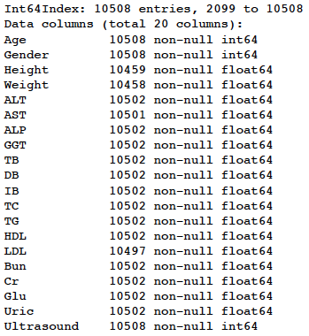
Exploratory Data Analysis
Features and their data types
Percentage of with missing values
Weight | 0.48%
Height | 0.47%
LDL | 0.10%
AST | 0.07%
Uric | 0.06%
ALT | 0.06%
ALP | 0.06%
GGT | 0.06%
TB | 0.06%
DB | 0.06%
TC | 0.06%
TG | 0.06%
HDL | 0.06%
Bun | 0.06%
Cr | 0.06%
Glu | 0.06%
IB | 0.06%
Gender | 0.00%
Ultrasound | 0.00%
Age | 0.00%
The percentage of cells without values is quite low.
Fill NaN with median value using Imputer.

Slide 7
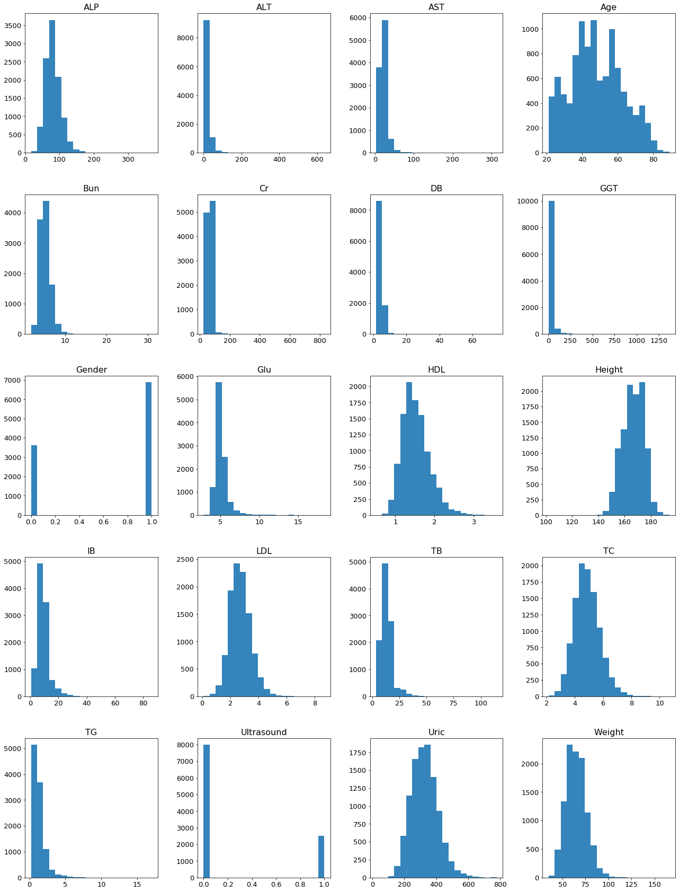
1. Gender is a categorical.
--Need transformation using OneHotEncoder.
2. The target (Ultrasound) is binary: 0/1.
3. The dataset is slightly imbalanced.
(class 0/1 ratio: 0.76/0.24)
3. Features are not on the same scale.
--Need standardization using StandardScaler.
4. Some features are heavily skewed due to extreme values.

Slide 8
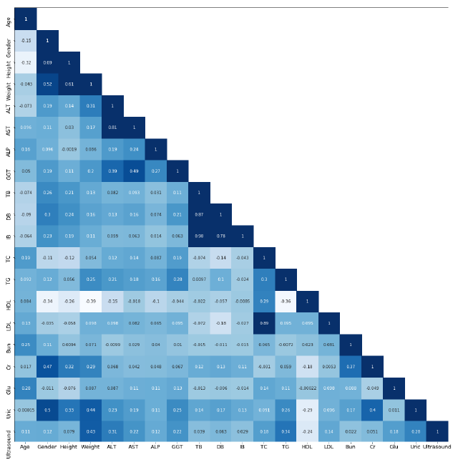
Coefficients with Ultrasound
Weight | 0.433068
TG | 0.340199
ALT | 0.313111
Uric | 0.284872
GGT | 0.223252
AST | 0.221504
TC | 0.179682
Glu | 0.177103
LDL | 0.137347
ALP | 0.12347
Gender | 0.120364
Age | 0.114844
Height | 0.078828
DB | 0.062637
Cr | 0.051007
TB | 0.039312
IB | 0.028512
Bun | 0.021694
HDL | -0.243348

Slide 9
Data Modeling & Flowcharts
Train and test splitting (70:30)
Numeric pipeline
Categorical pipeline
Full process pipeline
Model
Evaluation
Optimization
Comparison

Slide 10
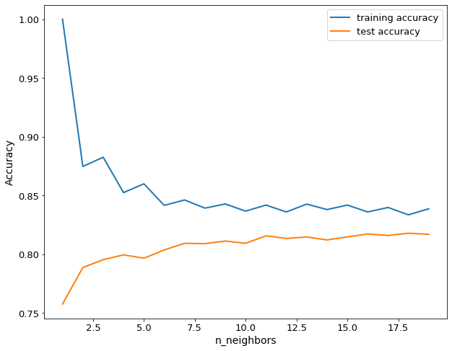
Results Visualization & Analysis
Select the best K parameter for KNN

Slide 11

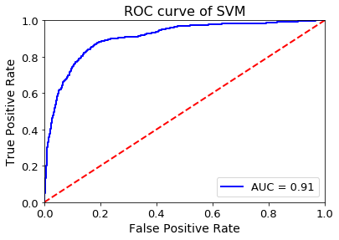

Slide 12
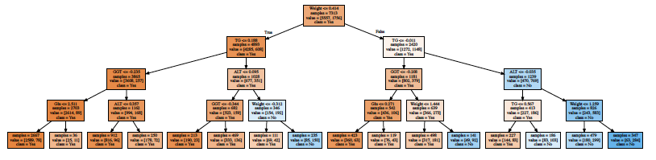
Decision Tree Classifier
Splitter features: Weight, TG, ALT, GGT, Glu
Training accuracy is: 0.8365737593473828
Testing accuracy is: 0.8182683158896289

Slide 13
Extract Important Features from the Random Forest Classifier

Slide 14
Optimization and Comparison
Without oversampling
VS
Oversampling
VS
Oversampling + Selected features

Slide 15
Evaluate model performance using Auc and F1 scores

Slide 17
Conclusions
In this project, Radom Forest is the best model with the F1 score of 0.92 and Auc score of 0.98, and then is SVM with the F1 core of 0.84 and Auc score of 0.90.
Machine Learning is powerful in accurately predicting the presence of a disease. It would be very promising in early diagnosis without applying interventional methods.

Slide 18
Perspectives
Limitations of this dataset:
The target feature is the result of ultrasound test, instead of the diagnosis golden standard biopsy.
The number of features may be not big enough since the underlying mechanisms of a disease is complex.
Future study:
Include more features, perform feature engineering, try different scaling methods, and apply neural network algorithms.

Slide 19
References
Grber, M.L. (2013) The incidence of diagnostic error in medicine. BMJ Quality & Safety. 22:II21-II27.
Otoom, A.F., Abdallah, E.E., Kilani, Y., Kefaye, A. and Ashour, M. (2015) Effective Diagnosis and Monitoring of Heart Disease. International Journal of Software Engineering and Its Applications. 9, 143-156.
Sen, S.K. and Dash, S. (2014) Application of Meta Learning Algorithms for the Pre- diction of Diabetes Disease. International Journal of Advance Research in Computer Science and Management Studies. 2, 396-401.
Karlik, B. (2011) Hepatitis Disease Diagnosis Using Back Propagation and the Naive Bayes Classifiers. Journal of Science and Technology. 1, 49-62.
Fatima, M. and Pasha, M. (2017) Survey of Machine Learning Algorithms for Disease Diagnostic. Journal of Intelligent Learning Systems and Appli- cations. 9, 1-16.
Futoma, J, Hariharan, S, Heller, K, et al. (2017) An Improved Multi-Output Gaussian Process RNN with Real-Time Validation for Early Sepsis Detection. Proceedings of Machine Learning for Healthcare.
Ma, Han., Xu, C.F., Shen, Z., Yu, CH. and Li, Y.M. (2018) Application of Machine Learning Techniques for Clinical Predictive Modeling: A Cross-Sectional Study on Nonalcoholic Fatty Liver Disease in China. Biomed Res Int. 2018 Oct 3;2018:4304376.

